Slide 1

15EC496L – MAJOR PROJECT
First Review
POLLUTION AND WEATHER MONITORING USING LORA
Domain – Embedded system design
Team Members : Supervisor:
Y.Aravind Kumar Reddy - RA1511004010083 Mrs.K.Suganthi
P.Mohan kumar - RA1511004010077 Assistant Professor (S.G),
P.Afjal Ali Khan - RA1511004010108 Dept. of ECE, SRMIST
K.Sai Pavan - RA1511004010087 Kattankullathur

Slide 2
INDEX
1.ABSTRACT
2.OBJECTIVE
3.PROBLEM STATEMENT
4.PROPOSED MODEL AND EXISTING MODEL
5.LITERATURE REVIEW
6. NOVELITY
7.BLOCK DIAGRAM & FLOW CHART
8.HARDWARE DESCRIPTION & SPECIFICATIONS
9.WORK PROGRESS
10.APPLICATIONS
11.FUTURE WORK
12.CONCLUSION

Slide 3
Abstract
Air pollution is one of the major environmental issues that cannot be ignored.
The range of communication takes place an important role while monitoring air pollution .
LORA is based on technology of wireless systems and it is designed to transmit and receive desired data from a point to another point even in remote areas in absence of Internet.

Slide 4
Objectives
To design a smarter equipment which is smaller in size, economical, has a better accuracy, compact and less complex in operation.
Power-efficient, long-range communication enabled, automated, and decentralized IOT based pollution monitoring system .

Slide 5
EXISTING MODEL
PROPOSED MODEL
Data not received accurately
No storage devices used
Used for only short Range distances
Uses high power consumption
Data receiving is very high
Automatic control
Cloud storage is used
It can be used for Long Range distances.
Power consumption is low
Data is secured

Slide 6
LITERATURE REVIEW
[1]TITLE NAME : Wireless self powered Environmental monitoring system for smart cities based on LORA
AUTHOR NAME : konstanitinos tzrtzakis, konstantinos papa fotis and paul p.sotiriadis
CONFERENCE AND PUBLISHED YEAR : PANHELLENIC conference on electronics and telecommunication(PACET),IEEE2017
DESCRIPTION : This system is completely reliable and also ensured that there is no packet loss between connectivity of the system and that energy provided is sufficient.
DRAWBACK :Microcontroller handles the data storage and processing,Network synchronization cannot be done.

Slide 7
[2]TITLE NAME : LORAWAN – A low power WAN protocol for Internet of things: A review and opportunities
AUTHOR NAME : jonathan d carvalho silva,joel J.P.C Rodrigues,Antonino M Alberti,petar solic,Andre L.L Aquino
CONFERENCE AND PUBLISHED YEAR : National Institute of telecommunication ,IEEE 2017
DESCRIPTION : This paper elaborates an analysis about LORAWAN protocol based on its architecture includes save energy, Latency, Range coverage and bandwidth of LORA module .This model helps to extend battery lifetime and energy sufficiency in WSN(Wireless Sensor Networks).
DRAWBACK :To support the expected nodes in IOT lot of sensors have to connect ,Limited energy ,Transmits few bytes every time.

Slide 8
[3]TITLE NAME : A secure Device to Device Link Establishment Schemefor LORAWAN
AUTHOR NAME : Jaecyu Kim,JooSeok song
CONFERENCE AND PUBLISHED YEAR :IEEE sensors journal,IEEE2018
DESCRIPTION :This paper proposes a secured device to device link establishment scheme to protect device to device communication in LoRaWAN, Device to Device communication can satisfy mutual authentication, confidentiality and message integrity.
DRAWBACK :This security can impact on battery consumption up to
5% and for mutual authentication 4-5% battery drain.

Slide 9
[4]TITLE NAME : On fast prototyping LORAWAN: a cheap and open platform for daily experiments.
AUTHOR NAME : Mariano Pulpito,Paolo Fornarelli,Claudio Pomo,Pietro Boccadoro
CONFERENCE AND PUBLISHED YEAR : IEEE wireless sensor systems conference,IEEE 2018
DESCRIPTION :In this paper its shows that a clear example of the noticeable possibilities offered by rapid prototyping. this also gives a wide solutions in low cost embedded boards and open source software solutions to accessibility
DRAWBACK : It seeks different trade off between modulation scheme, bandwidth occupation, latency, downlink and uplink, Closed source and property.

Slide 10
[5]TITLE NAME : On the Development of an Intelligent System for Particulate Matter Air Pollution Monitoring, Analysis and Forecasting in Urban Regions.
AUTHOR NAME : Mihaela Oprea1*, Cornel Ianache1 , Sanda Florentina, Daniel Dunea, Stefania Iordache
CONFERENCE AND PUBLISHED YEAR : IEEE wireless sensor systems conference,IEEE 2017
DESCRIPTION :The paper presents details on the development of an intelligent system for particulate matter (PM) air pollution monitoring, analysis and forecasting in two pilot cities. An in-situ PM10

Slide 11
Novelty
This project is supposed to work in remote areas to monitor pollution levels in the atmosphere by using some sort of sensor network.
Till now this project is done by using wifi,sigFox etc .but the range or data rate is less compared to LoRa.

Slide 12
SYSTEM/ARCHITECTURE DESIGN
IOT SENSORS
INTERNET
(using RPI)
INTERNET
(using LORAWAN)
THE THINGS NETWORK
INTERNET
MONITORING WEB SERVER

Slide 13
SYSTEM/ARCHITECTURE DESIGN
Temperature
Arduino
THE THINGS NETWORK
Humidity
LORA TRANSMITTER
Co2
UART
ADC
INTERNET
NO
LORA RECIEVER
Wind Direction
MONITORING WEB SERVER
Rain Guage
Power Supply

Slide 14
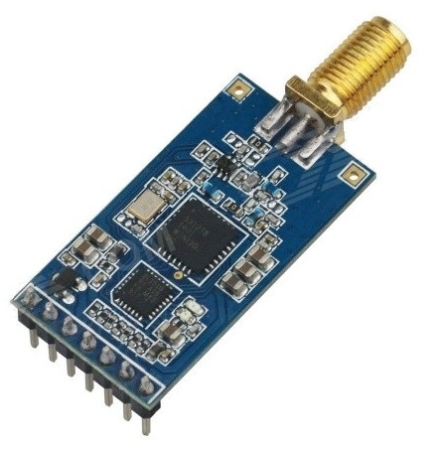
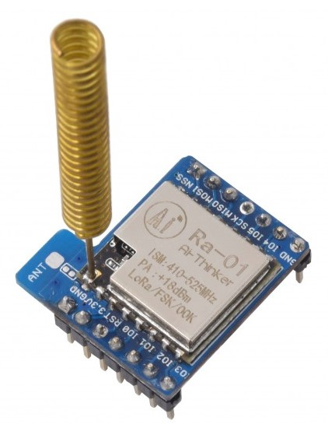
HARDWARE DESCRIPTION
LORA module – SX1278
Supply voltage Max - 3.9v
Temperature Max - +115°C
It have four pins namely, Vcc for power supply, RX for receiving the data and Tx is to transmit the data and finally fourth is ground.

Slide 15
LoRa Modulation
Designed to achieve high sensitivity using a cheap crystal 
Allows low power transmissions over long distances 
A form of Chirp spread spectrum. 
Data is encoded using the frequency increase/decrease rate 
Data rate and link condition determines the frequency bandwidth required 
Multiple parallel transmissions with different data rates on the same frequency 
Can receive signals 19.5 dB belownoise floor with forward error correction (FEC) 

Slide 16
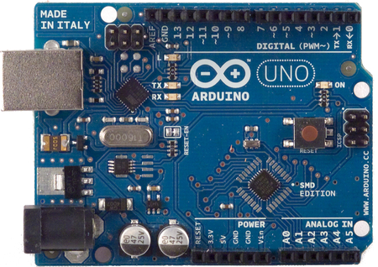
Arduino Uno
A microcontroller board based on the ATmega328
It has 14 digital input/output pins,6 analog inputs, a 16 MHz crystal oscillator, a USB connection, a power jack, an ICSP header, and a reset button.
Operating Voltage - 5V
Clock Speed 16 MHz

Slide 17
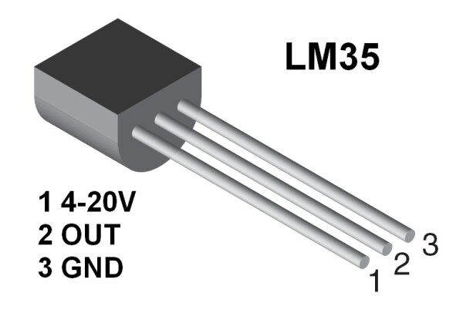
TEMPERATURE SENSOR(LM35)
Calibrated Directly in Celsius
Linear + 10-mV/°C Scale Factor
0.5°C Ensured Accuracy (at 25°C)
Rated for Full −55°C to 150°C Range
Operates from 4 V to 30 V
Low Self-Heating, 0.08°C in Still Air

Slide 18
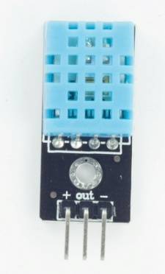
Humidity Sensor – DHT11
Ultra-low cost digital humidity sensor
New data can be collected for every 2 seconds
It have three pins,
Pin 1 connected to ground
Pin 2 connected to Vcc
Pin 3 connected analog data line

Slide 19
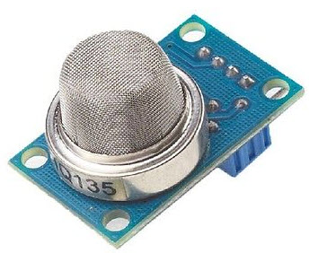
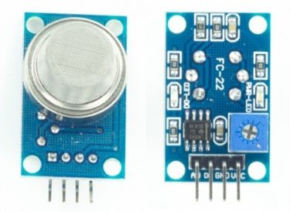
CO2 Sensor – MQ135
Suitable for detecting CO2,NH3, NOx, alcohol, benzene, smoke.
It has three pins
Pin 1 connected to Vcc
Pin 2 connected to ground
Pin 3 connected data line
NO Sensor – MQ2
It have three pins namely, pin one is Vcc pin which is connected to power supply, pin two is ground and finally pin three works as signal carrier

Slide 20
Work Progress
Work Completed | Work Planning to do
Literature Survey | Sensor Interfacing with Arduino
Component Selection & Acquisition | Lora Transmission testing
TheThingsNetwork Cloud Application | Data collection of data
SQL for Data management | Updatation to TTN
Arduino Interface Programming

Slide 21
APPLICTIONS
Monitoring of Weather and pollution with high range
End-to-end device with limited energy transmits few bytes every time.
LORAWAN protocols to decide the actions of security checks
High ADR(Adaptive Data Rate).
Spreading factor devices.

Slide 22
CONCLUSION
By this we conclude that the theoretical analysis about LoRa and about the project has done and we will be doing our implementation part.

Slide 23
FUTURE WORK
JANUARY LAST WEEK:
Ground work for components, testing individual components for accuracy and better performance.
FEBRAURY FIRST WEEK:
Setting up of cloud storage with the help of The Things Network for monitoring of data.
FEBRAURY SECOND WEEK:
LORAWAN Interfacing with Arduino and The Things Network with required software consideration.
BEFORE SECOND REVIEW:
With the completion of 70% work by connecting all sensors which are required to monitor and if any errors occurs, Replaceable of components.

Slide 24
MARCH FIRST WEEK:
All connections and interfacing problems has to clear for betterment of Project
MARCH SECOND WEEK:
Testing of project with partial output with monitoring of weather and pollution with Real time constraints.
BEFORE THIRD REVIEW:
100% work will be finished and we will store the data with different dates periodically
APRIL WORK:
All Poster presentation work will be prepared.

Slide 25
REFERENCES
[1]LoRa Wide Area Networks from an Internet of things Perspective,Alexandru Larvic,Valentin Popa,IEEE 2017
[2]A secure LoRaWAN sensor network architecture, Bogdan Oiga,Vasile Dadalat,Elie De Poorter,Adrian Munteaun,IEEE 2017
[3] A secure Device to Device Link Establishment Schemefor LoRaWAN,Jaecyu Kim,JooSeok song,IEEE sensors journal,IEEE2018
[4] LoRaWAN – A low power WAN protocol for Internet of things: A review and opportunities, jonathan d carvalho silva,joel J.P.C Rodrigues,Antonino M Alberti,petar solic,Andre L.L Aquino, National Institute of telecommunication,IEEE 2017.
[5] Wireless self powered Environmental monitoring system for smart cities based on LoRa, konstanitinos tzrtzakis, konstantinos papa fotis and paul p.sotiriadis, PANHELLENIC conference on electronics and telecommunication,IEEE2017

Slide 26
THANK YOU

